Slide 1
Using Remote Method Invocation to Implement Callbacks

Slide 2
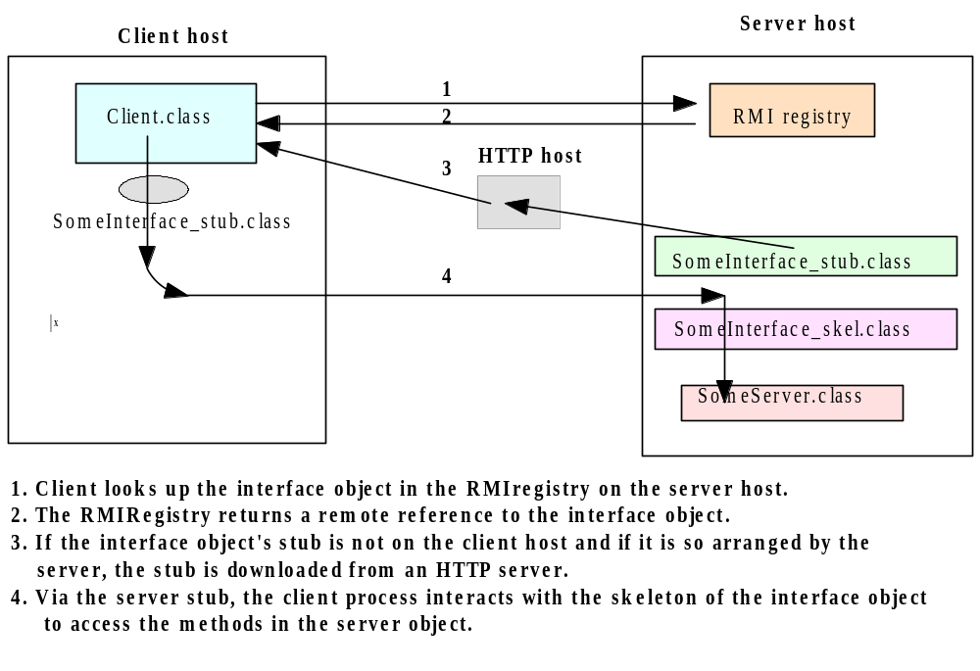
Java RMI Client Server Interaction

Slide 3
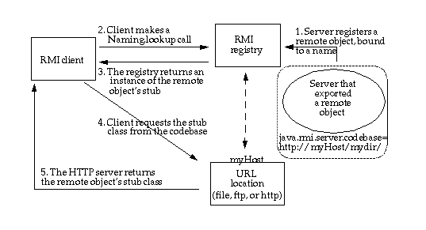
CodeBase
A codebase can be defined as a source, or a place, from which to load classes into a virtual machine

Slide 4
CodeBase
The remote object's codebase is specified by the remote object's server by setting the java.rmi.server.codebase property. The Java RMI server registers a remote object, bound to a name, with the Java RMI registry. The codebase set on the server VM is annotated to the remote object reference in the Java RMI registry.
The Java RMI client requests a reference to a named remote object. The reference (the remote object's stub instance) is what the client will use to make remote method calls to the remote object.
The Java RMI registry returns a reference (the stub instance) to the requested class. If the class definition for the stub instance can be found locally in the client's CLASSPATH , which is always searched before the codebase, the client will load the class locally. However, if the definition for the stub is not found in the client's CLASSPATH, the client will attempt to retrieve the class definition from the remote object's codebase.

Slide 5
CodeBase
The client requests the class definition from the codebase. The codebase the client uses is the URL that was annotated to the stub instance when the stub class was loaded by the registry.
The class definition for the stub (and any other class(es) that it needs) is downloaded to the client.
Now the client has all the information that it needs to invoke remote methods on the remote object. The stub instance acts as a proxy to the remote object that exists on the server; so unlike the applet which uses a codebase to execute code in its local VM, the Java RMI client uses the remote object's codebase to execute code in another, potentially remote VM
In addition to downloading stubs and their associated classes to clients, the java.rmi.server.codebase property can be used to specify a location from which any class, not only stubs, can be downloaded.

Slide 6
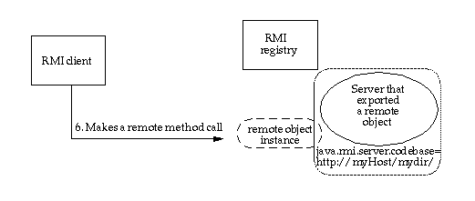
CodeBase
Java RMI client making a remote method call

Slide 7
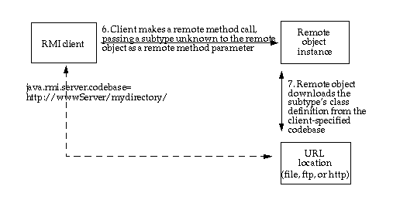
CodeBase
Java RMI client making a remote method call, passing an unknown subtype as a method parameter

Slide 8
Preparing for Deployment
Deploying an application that uses RMI can be tricky because so many things can go wrong and the error messages that you get when something does go wrong are so poor. Separate the class files into three subdirectories:
server
download
client
The server directory contains all files that are needed to run the server. You will later move these files to the machine running the server process. In our example, the server directory contains the following files:
server/
ProductServer.class
ProductImpl.class
Product.class

Slide 9
Preparing for Deployment
The client directory contains the files that are needed to start the client. These are
client/
ProductClient.class
Product.class
client.policy
You will deploy these files on the client computer. Finally, the download directory contains those class files needed by the RMI registry, the client, and the server, as well as the classes they depend on. In our example, the download directory looks like this:
download/
ProductImpl_Stub.class
java - Djava.rmi.server.codebase = http://localhost:8080/ download/ ProductServer &

Slide 10
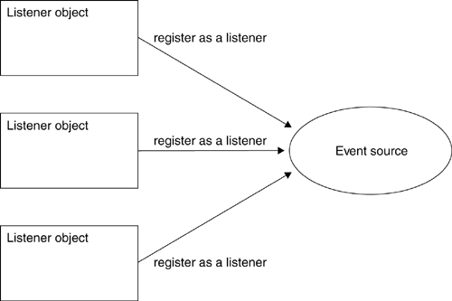
Using RMI to Implement Callbacks
Multiple listeners can register with one or more event sources.

Slide 11
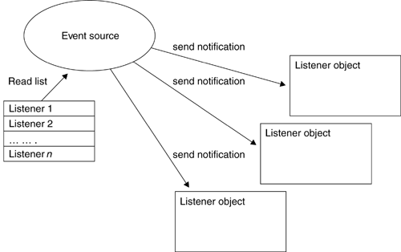
Using RMI to Implement Callbacks
Callback notification of event, for every registered listener

Slide 12
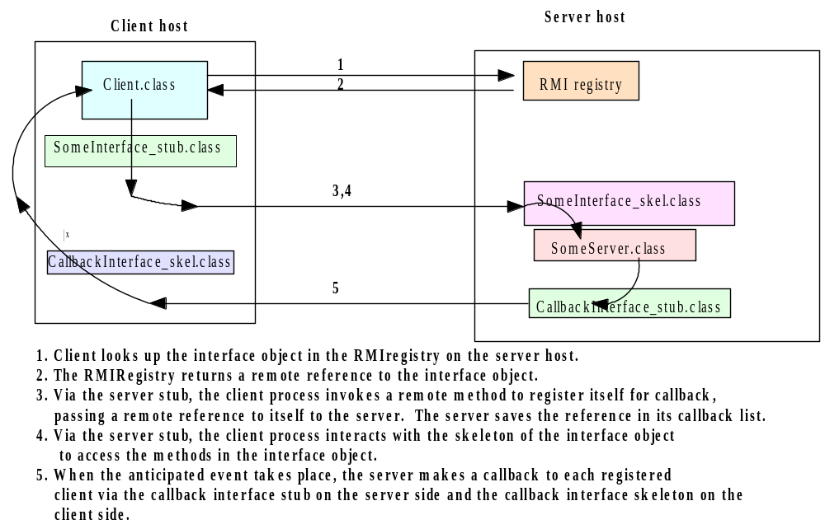
Callback Client-Server Interactions

Slide 13
Defining the Listener Interface
The listener interface defines a remote object with a single method. This method should be invoked by an event source whenever an event occurs, so as to act as notification that the event occurred. The method signifies a change in temperature, and allows the new temperature to be passed as a parameter.
interface TemperatureListener extends java.rmi.Remote {
public void temperatureChanged(double temperature)
throws java.rmi.RemoteException;
}

Slide 14
Defining the Event Source Interface
The event source must allow a listener to be registered and unregistered, and may optionally provide additional methods. In this case, a method to request the temperature on demand is offered.
interface TemperatureSensor extends java.rmi.Remote{
public double getTemperature()
throws java.rmi.RemoteException;
public void addTemperatureListener
(TemperatureListener listener )
throws java.rmi.RemoteException;
public void removeTemperatureListener
(TemperatureListener listener )
throws java.rmi.RemoteException;
}

Slide 15
Implementing the Event Source Interface
Once interfaces have been defined, the next step is to implement them. A TemperatureSensorServerImpl class is defined, which acts as an RMI server.
To notify registered listeners as a client (The server must extend UnicastRemoteObject, to offer a service, and implement the Temperature Sensor interface.
To create an instance of the service and registering it with the rmiregistry
To launch a new thread, responsible for updating the value of the temperature, based on randomly generated numbers. Both the amount (plus or minus 0.5 degrees) and the time delay between changes are generated randomly.
As each change occurs, registered listeners are notified, by reading from a list of listeners stored in a java.util.Vector object. This list is modified by the remote addTemperatureListener(TemperatureListener) and removeTemperatureListener(Tempera tureListener) methods.

Slide 16
Implementing the Event Source Interface
public class TemperatureSensorImpl extends UnicastRemoteObject implements TemperatureSensor, Runnable {
private volatile double temp;
private Vector list = new Vector();
public TemperatureSensorImpl() throws java.rmi.RemoteException {
super();
temp = 98.0; // Assign a default setting for the temperature
}
public double getTemperature() throws java.rmi.RemoteException {
return temp;
}
public void addTemperatureListener(TemperatureListener listener)
throws java.rmi.RemoteException {
System.out.println("adding listener -" + listener);
list.add(listener);
}
public void removeTemperatureListener(TemperatureListener listener)
throws java.rmi.RemoteException {
System.out.println("removing listener -" + listener);
list.remove(listener);
}

Slide 17
Implementing the Event Source Interface
public void run() {
Random r = new Random();
for (; ; ) {
try {
// Sleep for a random amount of time
int duration = r.nextInt() % 10000 + 2000;
// Check to see if negative, if so, reverse
if (duration < 0) duration = duration * -1;
Thread.sleep(duration);
} catch (InterruptedException ie) {}
// Get a number, to see if temp goes up or down
int num = r.nextInt();
if (num < 0) temp += 0.5; else temp -= 0.5;
notifyListeners(); // Notify registered listeners
}}

Slide 18
Implementing the Event Source Interface
private void notifyListeners() {
// Notify every listener in the registered list
for (Enumeration e = list.elements(); e.hasMoreElements();) {
TemperatureListener listener = (TemperatureListener)
e.nextElement();
// Notify, if possible a listener
try {
listener.temperatureChanged(temp);
} catch (RemoteException re) {
System.out.println("removing listener -" + listener);
// Remove the listener
list.remove(listener);
} }
} }

Slide 19
Implementing the Listener Interface
The temperature monitor client must implement the TemperatureListener interface, and register itself with the remote temperature sensor service, by invoking the TemperatureSensor.addTemperatureListener (Temperature Listener) method.
By registering as a listener, the monitor client will be notified of changes as they occur, using a remote callback. The client waits patiently for any changes, and though it does not ever remove itself as a listener, functionality to achieve this is supplied by the
TemperatureSensor.removeTemperatureListener( TemperatureListener)
method.

Slide 20
Implementing the Listener Interface
import java.rmi.*;
import java.rmi.server.*;
public class TemperatureListenerImpl extends UnicastRemoteObject implements TemperatureListener {
// Default constructor throws a RemoteException
public TemperatureListenerImpl() throws RemoteException {
super();
}
public void temperatureChanged(double temperature) throws java.rmi.RemoteException {
System.out.println("Temperature change event : " + temperature);
}
}

Slide 21
TemperatureSensorServer
public class TemperatureSensorServer{
public static void main(String args[]) {
System.out.println("Loading temperature service");
try {
// Load the service
TemperatureSensorImpl sensor = new TemperatureSensorImpl();
// Register with service so that clients can find us
String registry = "localhost";
String registration = "rmi://" + registry + "/TemperatureSensor";
Naming.rebind(registration, sensor);
// Create a thread, and pass the sensor server. This will activate the //run() method, and trigger regular temperature changes.
Thread thread = new Thread(sensor);
thread.start();
} catch (RemoteException re) {
System.err.println("Remote Error - " + re);
} catch (Exception e) {
System.err.println("Error - " + e);
}
}}

Slide 22
TemperatureMonitor
public static void main(String args[]) {
System.out.println("Looking for temperature sensor");
try {
// Lookup the service in the registry, and obtain a remote service
String registry = "localhost";
String registration = "rmi://" + registry + "/TemperatureSensor";
Remote remoteService = Naming.lookup(registration);
// Cast to a TemperatureSensor interface
TemperatureSensor sensor = (TemperatureSensor) remoteService;
// Get and display current temperature
double reading = sensor.getTemperature();
System.out.println("Original temp : " + reading);
// Create a new monitor and register it as a listener with remote sensor
TemperatureListenerImpl monitor = new TemperatureListenerImpl();
sensor.addTemperatureListener(monitor);
} catch (RemoteException re) {
System.out.println("RMI Error - " + re);
} catch (Exception e) {
System.out.println("Error - " + e);
} }

Slide 23
Remote Object Activation
One of the chief disadvantages of using RMI for large and complex systems is the amount of overhead generated by RMI server software. Suppose you are constructing a massive system, with many different RMI service interfaces and server implementations.
Each server would have to be running continually, even if it was seldom used by client software. Servers must create and export remote objects that implement RMI service interfaces, which consumes memory and CPU time.
If each implementation is created as a separate server, this means that there will be as many JVM instances as there are services.
Remote object activation is a technique that solves the problem of running a large number of idle RMI services. It allows services to be registered with the rmiregistry, but not instantiated. Instead, they remain inactive, until called upon by a client, when they will awaken and perform their operation. A special daemon process called the remote method invocation activation system daemon (rmid) listens for these requests and instantiates RMI services on demand.

Slide 24
Creating an Activatable Remote Object
Creation of an activatable remote object is a little different from that of a UnicastRemoteObject, but the code is fairly similar.
public interface MyRemoteInterface extends java.rmi.Remote{
public void doSomething () throws java.rmi.RemoteException;
}
The next step is to create an implementation that extends the java.rmi.activation.Activatable class. It must implement our RMI interface and provide both a constructor and a doSomething() method. Unlike classes that extend the UnicastRemoteObject class, a different constructor signature is used. This constructor calls the parent constructor and exports the object on any available port. The service is then available for use by clients.

Slide 25
Implementing an Activatable Remote Object
public class MyRemoteInterfaceImpl extends java.rmi.activation.Activatable
implements MyRemoteInterface{
public MyRemoteInterfaceImpl (java.rmi.activation.ActivationID
activationID, java.rmi.MarshalledObject data) throws
java.rmi.RemoteException {
// call the Activatable(ActivationID activationID,
// int port) parent constructor
super (activationID, 0);
}
public void doSomething(){
System.out.println ("Doing something....");
}
}

Slide 26
Registering an Activatable Remote Object
Step One
The first step is to create an activation group descriptor. This descriptor is associated with an activation group, and allows you to specify system properties. In this example, no system properties are required and a new instance of the Properties class is created.
// Step one : create an ActivationGroupDesc instance
ActivationGroupDesc groupDescriptor = new ActivationGroupDesc(new Properties(), null);
Step Two
The second step is to register the activation group descriptor with the RMI activation daemon process. This process is represented by the Activation System interface. Applications do not create or extend this interface. Instead, a reference to the activation daemon process is obtained by invoking the static ActivationGroup.getSystem() method.
// Step two : register that activation group descriptor
// with the activation system, and get groupID
ActivationSystem system = ActivationGroup.getSystem();

Slide 27
Registering an Activatable Remote Object
Once a reference to the ActivationSystem class is obtained, the group descriptor is registered using the ActivationSystem.registerGroup method, which returns an ActivationGroupID instance.
// Register the group descriptor - without registering the
// group, no execution
ActivationGroupID groupID =
system.registerGroup(groupDescriptor);
Step Three
Once a group descriptor has been registered with the activation system and a valid ActivationGroupID obtained, the next step is to actually create the activation group. The act of registering it is not sufficient—one must be created, by calling the static ActivationGroup.createGroup( ActivationGroupID id, ActivationGroupDesc descriptor) method. This creates and assigns an activation group for the JVM, and notifies the activation system that the group is active.
// Step three: create an activation group, passing the
// group ID and descriptor as parameters
ActivationGroup.createGroup(groupID, groupDescriptor, 0);

Slide 28
Registering an Activatable Remote Object
Step Four
The fourth step is to create an activation descriptor, which describes an activatable remote object. It stores three key pieces of information: the class name of the remote object, the URL location of the remote object, and (optionally) a MarshalledObject that contains a serialized version of the remote object.
String strLoc = new File(".").getCanonicalFile().toURI().toString();
// whose constructor requires the class name, codebase, //and an optional marshalled object
ActivationDesc desc = new ActivationDesc("RMIActivationLightBulbImpl", strLoc, null);
Step Five
The fifth step is to register the activation descriptor with the activation system. This instructs the activation system of the class name and the location of the class definition file. A remote stub will be returned, which can then be registered as an RMI service.
// Step five : Register the object with the activation system
// Returns a stub, which may be registered with rmiregistry
Remote stub = Activatable.register(desc);

Slide 29
Registering an Activatable Remote Object
Step Six
The sixth and final step is to add a registry entry for the RMI service, so that clients may locate the service. The code for this is similar to that of the previous RMI lightbulb server, except that a remote stub is registered, not an instance of a remote object.
// Check to see if a registry was specified
String registry = "localhost";
// Registration format //registry_hostname:port/service
// Note the :port field is optional
String registration = "rmi://" + registry + "/RMILightBulb";
// Step six : Register the stub with the rmiregistry
Naming.rebind(registration, stub);
System.out.println("Service registered with rmid. Now
terminating...");
System.exit(0);

Slide 30
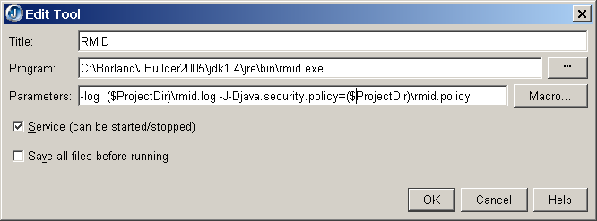
Configuring a RMID

